Slide 1


Dikaios Amanah
A Shariah-Compliant Musharakah-Based Micro-Investment Platform for SMEs
Empowering Ethical Investment Through Trust, Transparency, and Technology
Presented by:
Mehedi Hassan Bhuiyan
Dept. of Computer Science & Engineering
University of Information Technology & Sciences

Slide 2

Two People. One Shared Challenge.
Abdul Karim (SME)
Rahim Ahmed (Investor)
Owns a tailoring shop in Dhaka and wants to expand.
Young software engineer seeking opportunities.
Needs ৳50,000 for new equipment.
Has ৳8000 in savings.
Cannot secure a bank loan (no collateral).
Wants to invest ethically (profit-sharing).
Prefers interest-free financing.
Cannot easily identify trustworthy SMEs.
One needs capital. The other wants to invest ethically. Technology can connect them safely.

Slide 3

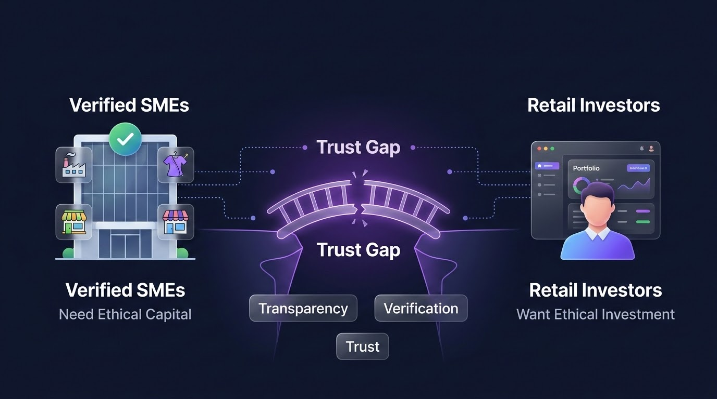
The Financing Gap in Bangladesh
Capital exists. Businesses exist. Trust is missing.
SME Challenges
Investor Challenges
Banks require collateral.
Idle savings remain unused.
Interest-based loans limit options.
Few transparent halal options.
Poor visibility to investors.
High fear of fraud.

Slide 4

Existing Solutions Fall Short
Solution | Core Limitation
Banks | Require physical collateral and charge fixed interest.
Islamic Banks | Institution-driven; lacks direct connection between retail investors and SMEs.
Venture Capital | Primarily targets high-growth tech startups, ignoring traditional SMEs.
Crowdfunding | Limited strict verification, risk assessment, or structured profit-sharing.
Informal Investment | Extremely low transparency, high risk, and legal uncertainty.
No single platform provides ethical investment, SME verification, and digital auditability together.

Slide 5

Our Solution:
Dikaios Amanah
A secure digital ecosystem connecting verified SMEs with retail investors through transparent, Shariah-compliant investments.
Ethical Financing: Profit/loss sharing (Musharakah).
Verified Ecosystem: Strict SME screening & KYC.
Transparent Investment: Clear digital dashboards.
Technology-Driven Trust: Blockchain audit trails.
Secure Management: Encrypted document storage.

Slide 6




The Business Owner Journey
SMEs receive structured, transparent, and ethical financing while maintaining accountability.
2. Funding
4. Distribution
Campaign publication and retail investors fund the approved business.
Profit declaration and equitable distribution based on Musharakah.
1. Verification
3. Operations
Registration, document upload, KYC, and rigorous admin risk assessment.
Capital utilization alongside transparent monthly progress reporting.

Slide 7
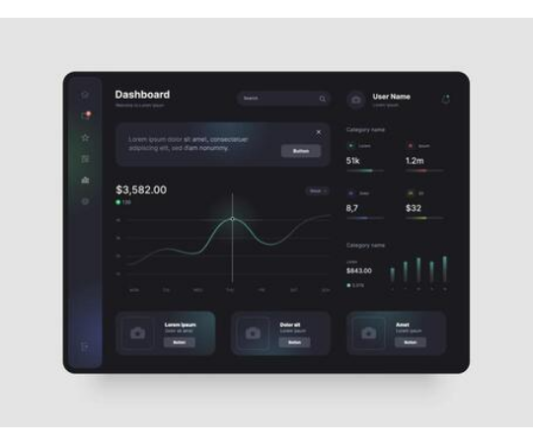
The Investor Journey
Transparent, accessible, and ethical investment backed by verified information.
Discover: Complete KYC and browse verified business campaigns.
Analyze: Review risk scores, financials, and comprehensive profiles.
Invest: Allocate funds directly to chosen SMEs.
Track: Monitor portfolio performance via live dashboard.
Earn: Receive business updates and profit distributions safely.

Slide 8





End-to-End Workflow
1. Onboarding
2. Marketplace
3. Settlement
Businesses and Investors register. System performs KYC and deep risk assessment before granting platform access.
Approved campaigns go live. Investors fund businesses, triggering a digital Musharakah contract generation.
Businesses report monthly. Profits are distributed, and all critical actions are logged in the blockchain audit trail.

Slide 9
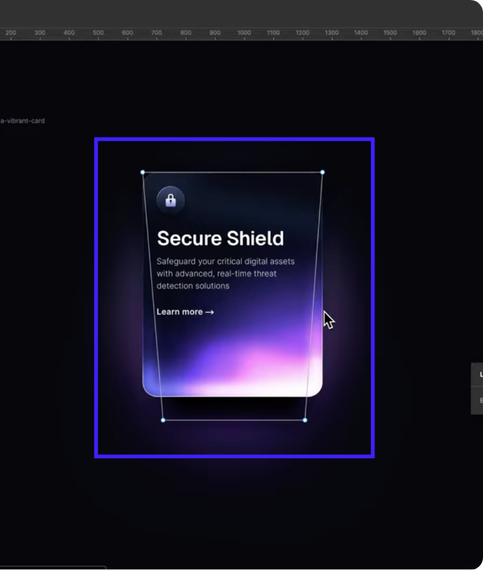
System Architecture
Structured Software Engineering separating concerns for security and scalability.
Presentation Layer: React Web Application
Application Layer: Node/Express REST API
Core Services: Verification, Investments, Reporting
Security Layer: JWT, RBAC, Data Validation
Data Layer: PostgreSQL (Primary DB)
Immutable Audit Layer: Permissioned Blockchain

Slide 10




Security & Trust Framework
Trust is achieved through multiple layers of engineering, not a single technology.
Access Control
Data Protection
App Security
JWT Authentication
AES-256 Encryption
Input Validation
Role-Based Access Control
bcrypt Password Hashing
Rate Limiting
Secure Session Management
SHA-256 Document Hashing
XSS & CSRF Protection

Slide 11
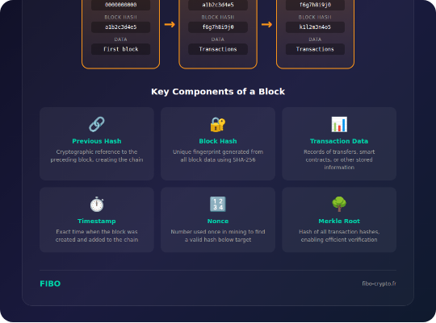

Why a Blockchain Audit Layer?
Traditional databases allow record modification. We use a permissioned blockchain strictly to make critical events tamper-evident.
What goes On-Chain? (Hashes)
Trade License & NID Hashes
Contract Timestamps & Digital Signatures
Investment & Profit Distribution Records
What stays Off-Chain? (Database/Cloud)
Full documents, PII, User passwords
Daily operational business data

Slide 12

Technology Stack
Layer | Technology | Purpose
Frontend | React.js | Component-based, responsive user interface
Backend | Node.js + Express.js | High-performance business logic & REST APIs
Database | PostgreSQL | ACID compliance and structured relational data
Storage | Firebase Storage | Secure cloud document storage
Security / Auth | JWT, bcrypt, AES-256 | Secure login, password hashing, encryption
Audit Layer | Hyperledger Fabric (Simulated) | Enterprise-grade permissioned immutable audit trail
Every technology was selected based on scalability, security, maintainability, and software engineering principles.

Slide 13







Sustainable Business Model
The platform does not earn income through interest. Revenue is generated through digital platform services.
Service Fee
Premium Verif.
Data Analytics
Featured Campaigns
Small administrative fee charged on successfully completed investment campaigns.
Advanced verification and certification tier for larger SMEs seeking trust.
Market insights and detailed investor engagement reports for businesses.
Promotional visibility for businesses wanting to boost their campaigns.

Slide 14


Minimum Viable Product (MVP)
Core Features (Included)
Future Enhancements
User Authentication & KYC
Mobile Application
Investor & Business Dashboards
Banking API Integration
SME Verification & Risk Assessment
Real Payment Gateway
Musharakah Campaign Creation
AI Risk Assessment
Investment Tracking & Reporting
BSEC Regulatory Compliance
Blockchain Audit Layer (Simulation)
Live Hyperledger Deployment

Slide 15




Expected Impact
SMEs
Investors
Bangladesh
Access to ethical capital
Ethical investment options
Financial inclusion
Greater business visibility
Portfolio diversification
Digital transformation
Transparent opportunities
Secure digital records
Ethical investment ecosystem

Slide 16




Project Roadmap
Phase 3 & 4
Phase 7 & 8
Core Development
Launch Readiness
Backend APIs, Database schema, Frontend integration.
QA Testing, Deployment, and Final Presentation.
Phase 1 & 2
Phase 5 & 6
Research & Design
Security & Audit
Requirements, Proposal, SRS, and UI/UX Prototyping.
Authentication, Encryption, and Blockchain Audit Layer.

Slide 17



Vision for the Future
The MVP establishes a foundation that can be expanded into a production-ready financial platform.
Technical Expansion
Ecosystem Integration
Native iOS & Android Mobile Applications
Direct Banking API & Payment Gateway Integration
Live Hyperledger Fabric Network Deployment
BSEC Compliance and Regulatory Dashboards
AI-Based Risk Scoring and Credit Analytics
Multi-language Support for Rural Inclusion
Automated Smart Contracts for Distribution
Regional Expansion beyond Urban Hubs

Slide 18
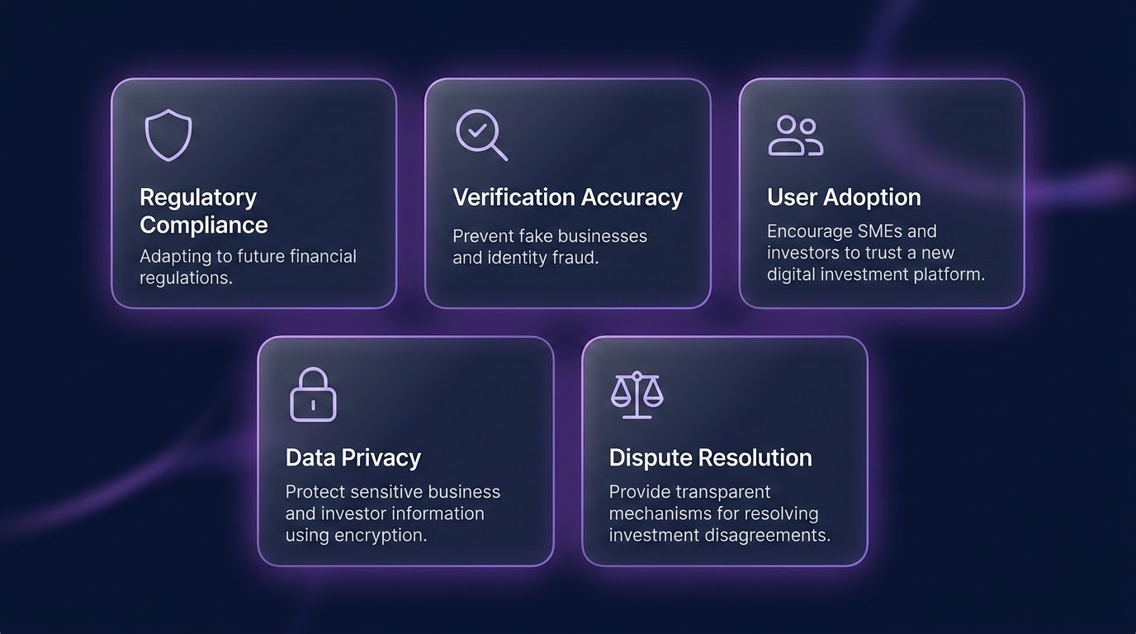
Acknowledging Risks & Challenges
Building secure finance requires vigilance.
Regulatory Compliance: Navigating BSEC laws.
Verification Accuracy: Preventing identity/business fraud.
User Adoption: Building trust among traditional SMEs.
Data Privacy: Protecting sensitive financial documents.
Dispute Resolution: Managing failed business outcomes.

Slide 19

Questions & Discussion
Thank you for your time and feedback.
Dikaios Amanah
Empowering Ethical SME Investment
Mehedi Hassan Bhuiyan | Dept. of Computer Science & Engineering | University of Information Technology & Sciences

